Slide 1
A GNURADIO-based Software Defined GPS Receiver
EECS 498 Course Project Final Presentation
Dinan Bai, Tianyu Yin

Slide 2
Content
GPS Background & Theory
GNUradio-based GPS receiver Design & Validation
Experiment
Our real in-situ Measurement in Ann Arbor
Conclusion

Slide 3
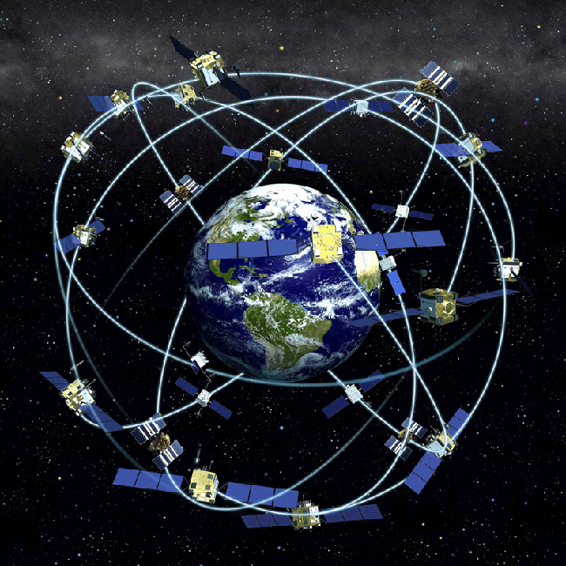
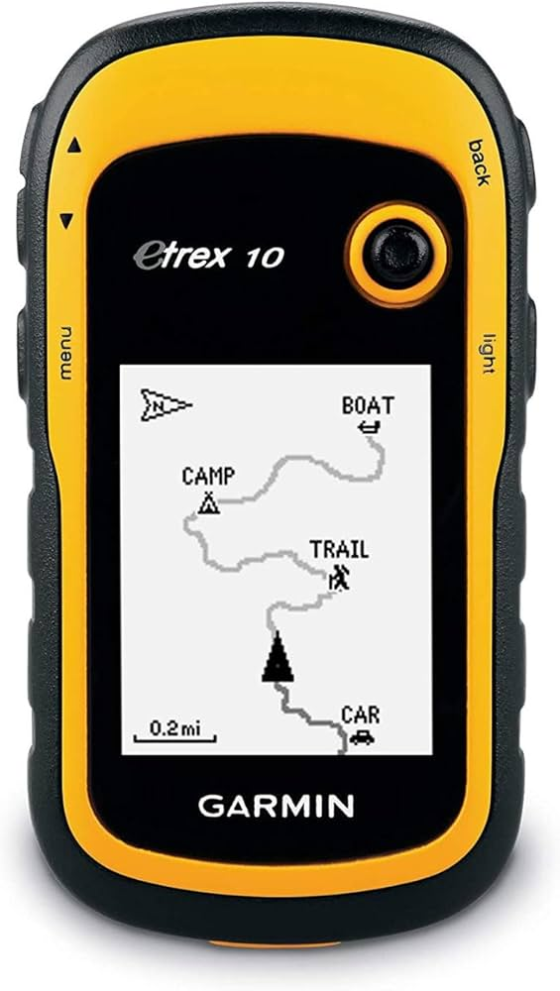
1. GPS Background
GPS Application: Navigation
Positioning a receiver
Idea behind it
We want to solve for x, y, z for a location
It requires at least 3 satellites locations & delay of signal propagation (If considering time bias, then need 4)
Each satellite transmits its ephemeris info to ground receiver
Ground receiver parses the ephemeris info and calculates its position
Source: https://spaceplace.nasa.gov/gps/en/

Slide 4
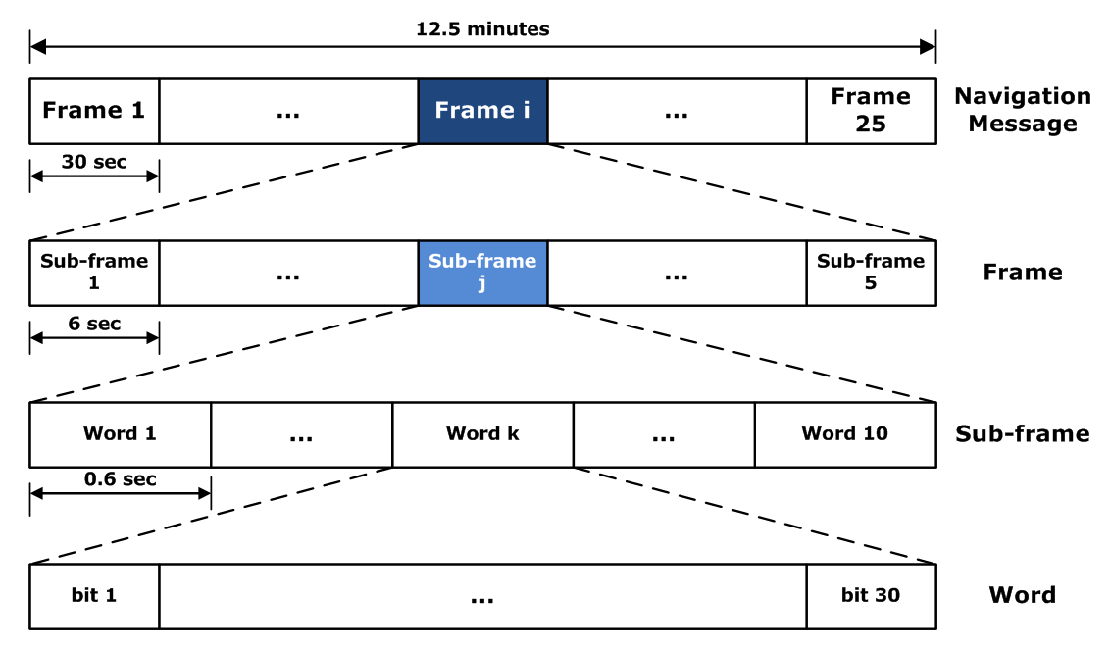
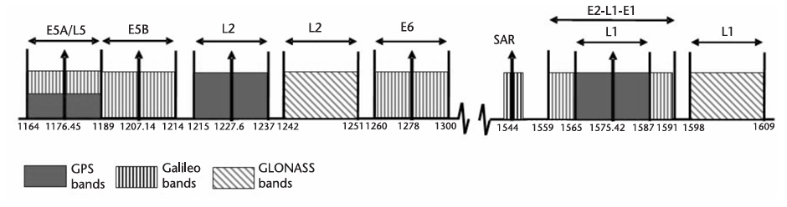
GPS transmits message bits: BPSK, 50 bps, or 1 bit for 20 ms
PRN
PRN
1ms
1ms
20ms, 20 PRN cycles for 1 navigation bit
However, due to channel effects …
Delay
Doppler frequency shift
Noise
we need to estimate timing/frequency (recall what we learned in class!) at the receiver to correctly receive GPS message bits
Use Pseudo Random Noise (PRN) codes!
32 GPS satellites are assigned with their own PRN code (e.g. PRN 1, PRN 2, … , PRN 32)
Different PRNs are orthogonal
In this project, we focus on the L1 band C/A code

Slide 5
2. Receiver Design Overview
Received signal
What we did
Acquisition
Tracking
How many PRNs can be detected?
Where are they? (delay & doppler)
Takes a long time (cold start)
Track the navigation bits at the estimated delay & doppler
Since we know them in the acquisition stage, it’s going to be fast
Navigation

Slide 6
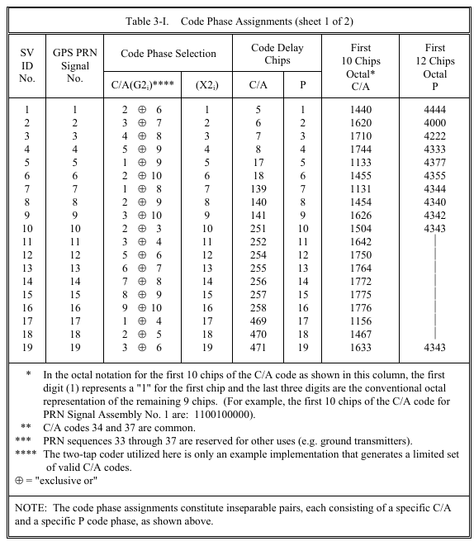
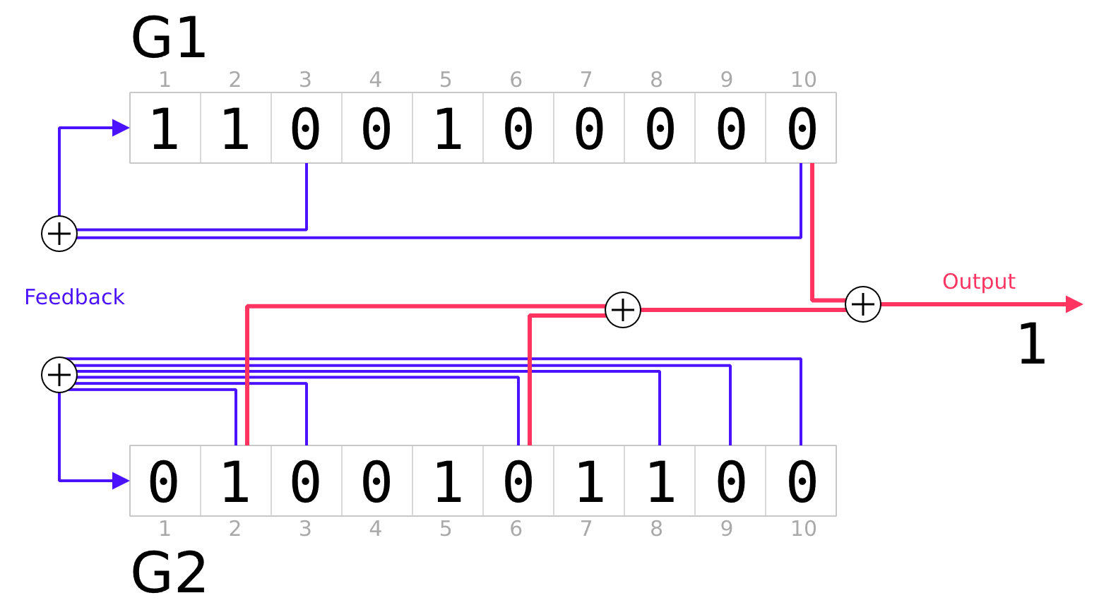
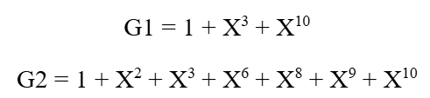
a. PRN code – L1 civil ranging code
C/A Code – Gold Code
One cycle: 1023 bits
Chipping rate: 1023 Kbps
Every cycle lasts 1 ms
Source: IS-GPS-200D

Slide 7
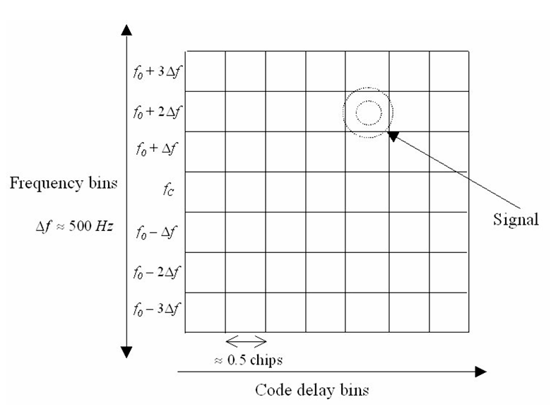
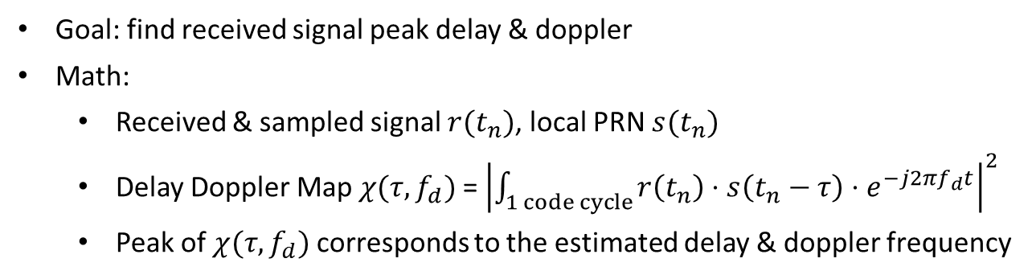
b. Acquisition – Delay Doppler Map:
Goal: find received signal peak delay & doppler
Math:
Received & sampled signal $r(t_{n})$, local PRN $s(t_{n})$
Delay Doppler Map $χ(τ,f_{d})$ = ${\left|\int_{1 code cycle}{r\left(t_{n}\right)⋅s\left(t_{n}−τ\right)⋅e^{−j2πf_{d}t}}\right|}^{2}$
Peak of $χ(τ,f_{d})$ corresponds to the estimated delay & doppler frequency
Notes:
We got. A received signal and local PRN
Then we can do a cross-correlation between received signal, and a time delay & freq shift version of local PRN
A delay doppler map is formed e.g. the figure
The magnitude peak in the ddm corresponds to the estimated delay and doppler frequency

Slide 8
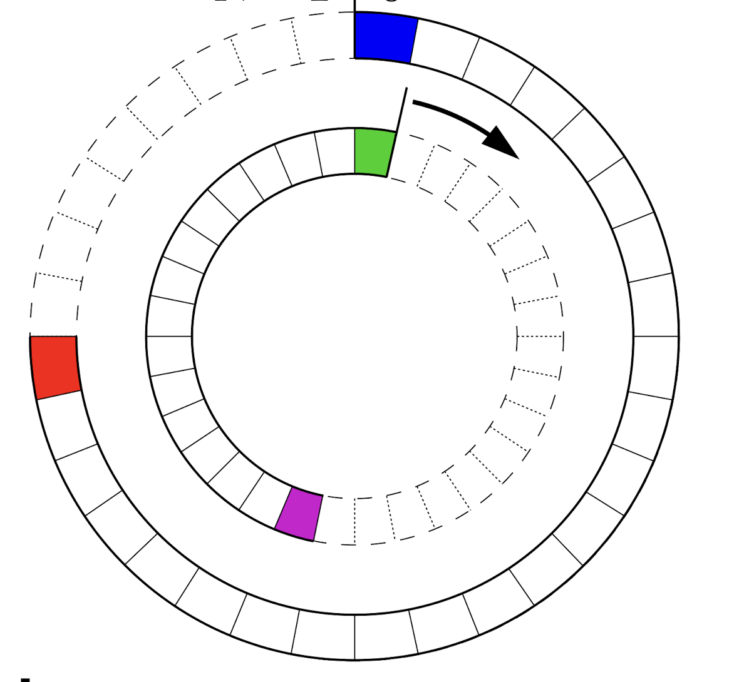
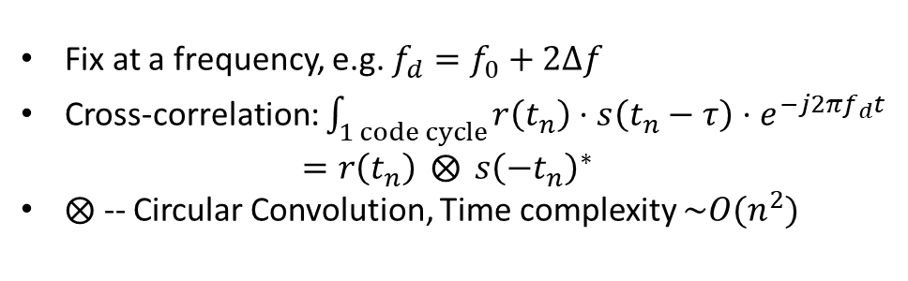
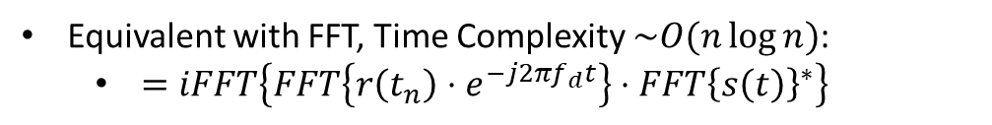
b. Acquisition – Time-lag Correlation:
Fix at a frequency, e.g. $f_{d}=f_{0}+2Δf$
Cross-correlation: $\int_{1 code cycle}{r\left(t_{n}\right)⋅s\left(t_{n}−τ\right)⋅e^{−j2πf_{d}t}}$ $=r\left(t_{n}\right) ⨂{ s{\left(−t_{n}\right)}^{∗}}$
$⨂$ -- Circular Convolution, Time complexity $\sim O(n^{2})$
Equivalent with FFT, Time Complexity $\sim O(n\log{n})$:
$=iFFT\left\{FFT\left\{r\left(t_{n}\right)⋅e^{−j2πf_{d}t}\right\}⋅FFT{\left\{s\left(t\right)\right\}}^{∗}\right\}$
PRN
PRN
PRN
1 ms signal
Equivalently, Circular Convolution! Then we can use FFT
PRN
1 ms signal
Notes:
Lets examine the time-lag correlation with a fixed frequency shift
Correlation is equivalent to convolution, but one of them is time reversed and conjugated
A simple way is to shift one signal by one bit delay, then calculate correlation, then next bit. When they are lined up, the correlation peaks and delay is found. In this way, the time complexity is o n2
Due to the periodicity equivalently this is a circular convolution
So we can apply FFT, the correlation is mathmatcially equivalent to
And the time complexity is o nlogn, becomes much faster when data amount is huge

Slide 9
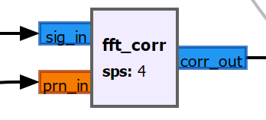
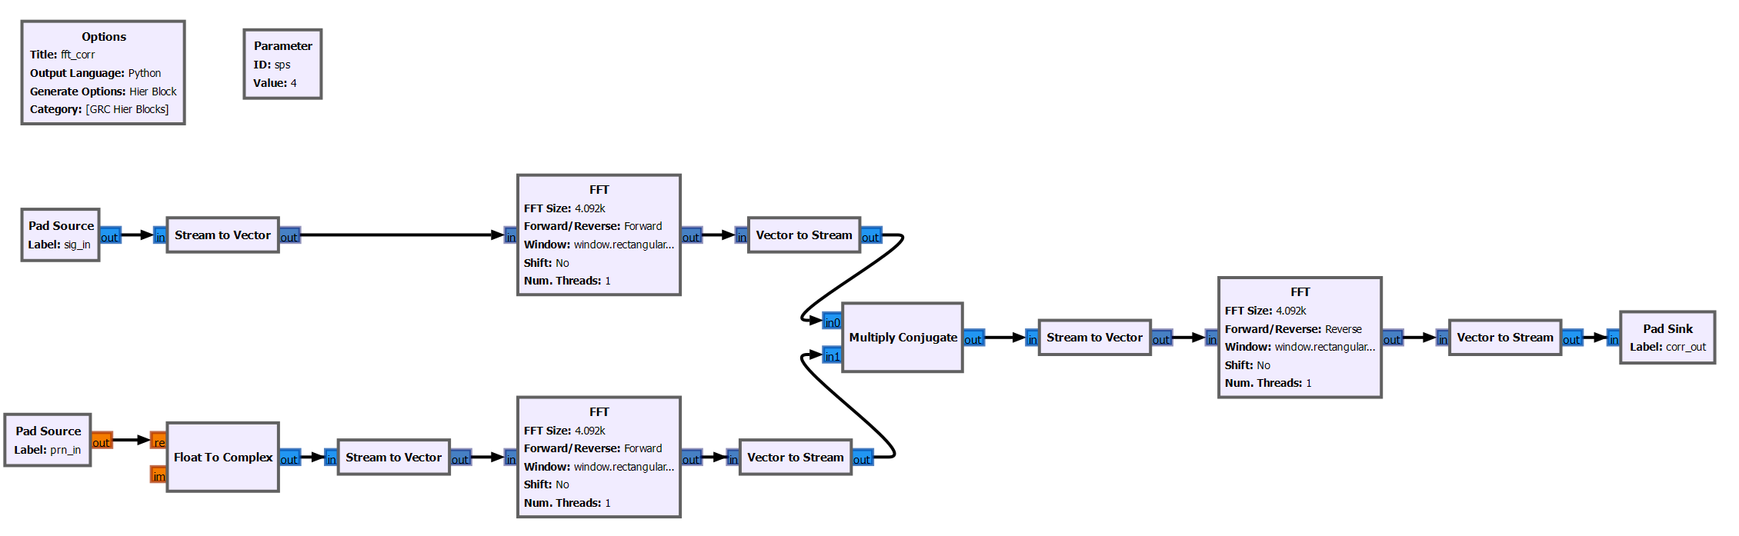


b. Acquisition – FFT based cross-correlation
$$iFFT\left\{FFT\left\{r\left(t_{n}\right)⋅e^{−j2πf_{d}t}\right\}⋅FFT{\left\{s\left(t\right)\right\}}^{∗}\right\}$$
$$r\left(t_{n}\right)⋅\exp{(−j2π{\hat{f}}_{d}t)}$$
Time-lag Correlation Waveform
$$s(t_{n})$$
Notes:
Gnuradio structure to realize the FFT-based xcorr
Hierarchy block
Input -- output

Slide 10
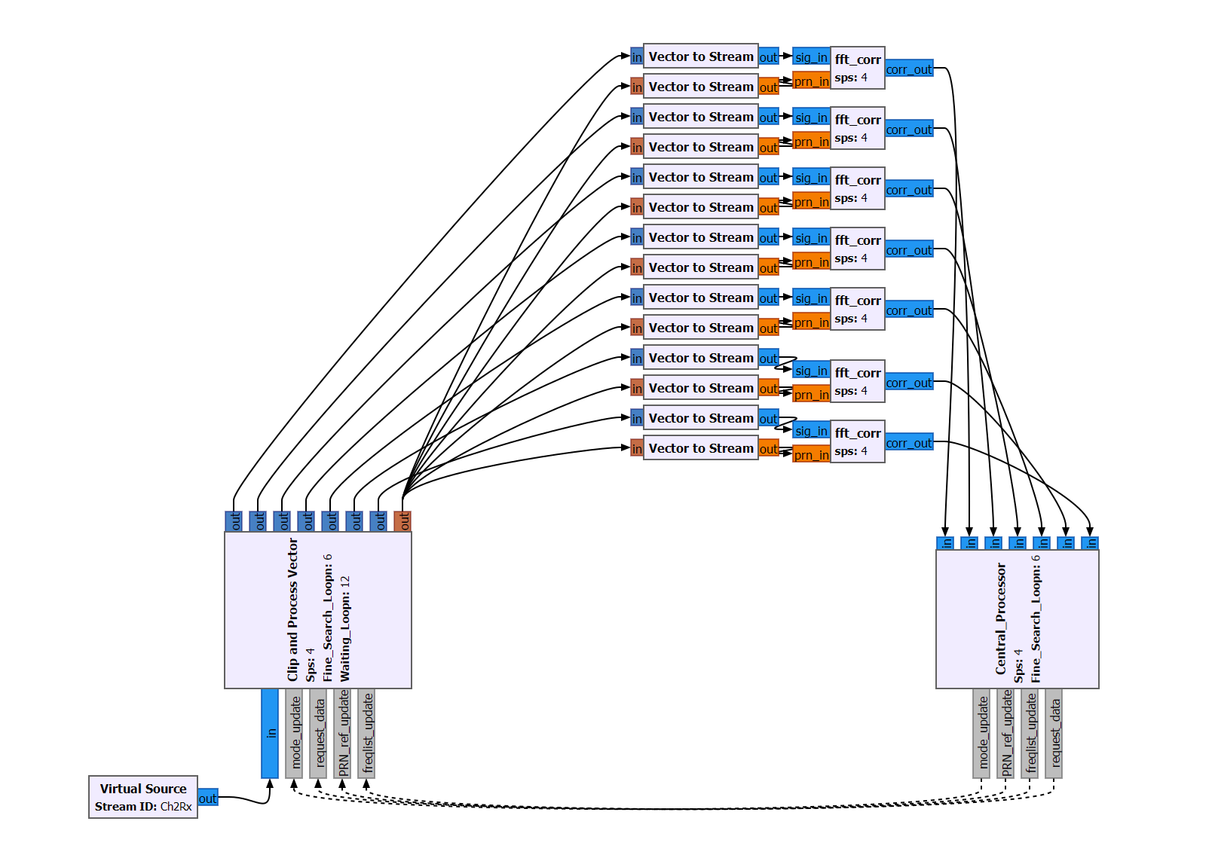
7-thread-parallel search of correlation
Why 7? Because my computer has 8 cores
Correlation based on shift: 10s for one PRN search
Correlation Based on FFT: 2 s for 32 PRNs
Notes:
Parallel the doppler search:
7 threads
Each output is a delay cut – if we take 4 samples per bit, the ddm size will be 7*1023*4. peak search
speed

Slide 11
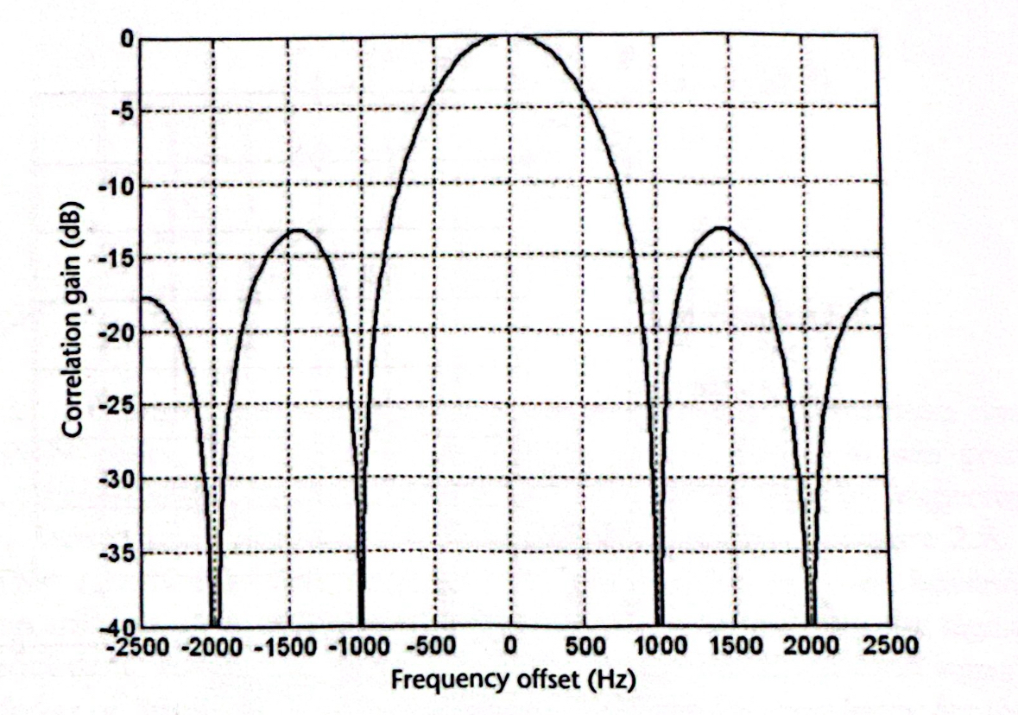
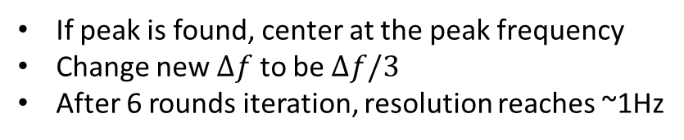
c. Frequency Coarse & Fine Search
Ambiguity function frequency cut
Coarse search:
500 Hz Bandwidth
First round: [-1500,-1000, -500, 0, 500, 1000, 1500] Hz
Not found?
Second: centered at 3500 Hz, 2000 to 5000 Hz
Third, negative of Second round frequency
In the end, at most 5 rounds search, cover -8.5 to 8.5 KHz
Still not found? Give up and move to the next PRN
Fine search:
If peak is found, center at the peak frequency
Change new $Δf$ to be $Δf/3$
After 6 rounds iteration, resolution reaches ~1Hz
Tracking:
If the peak and doppler frequency are known, then in the tracking stage, we can shrink the search range
Delay & doppler change slightly and continuously in time

Slide 12
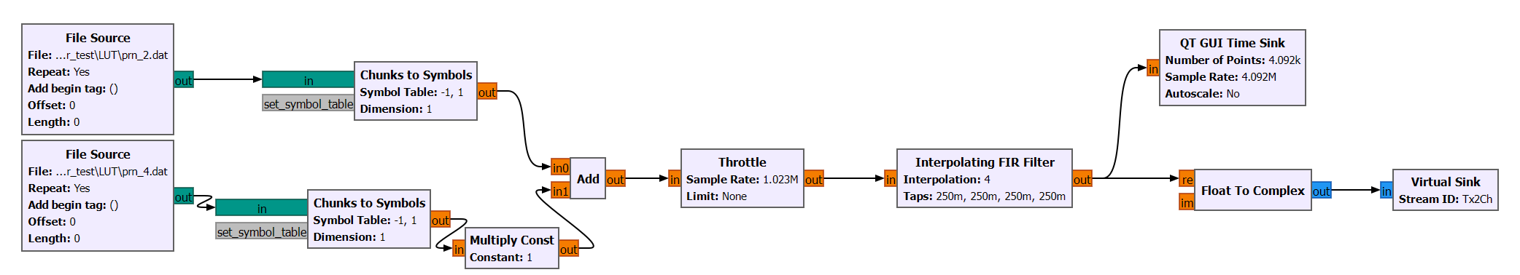
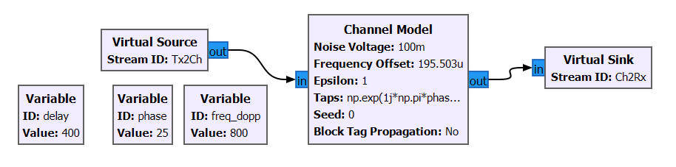
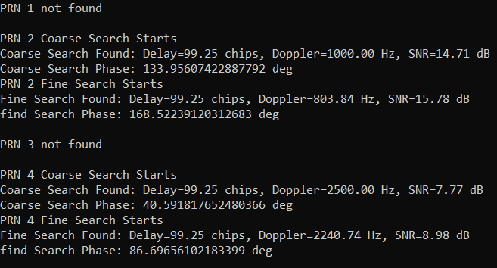
d. Validation1 – Simulation:

Slide 13
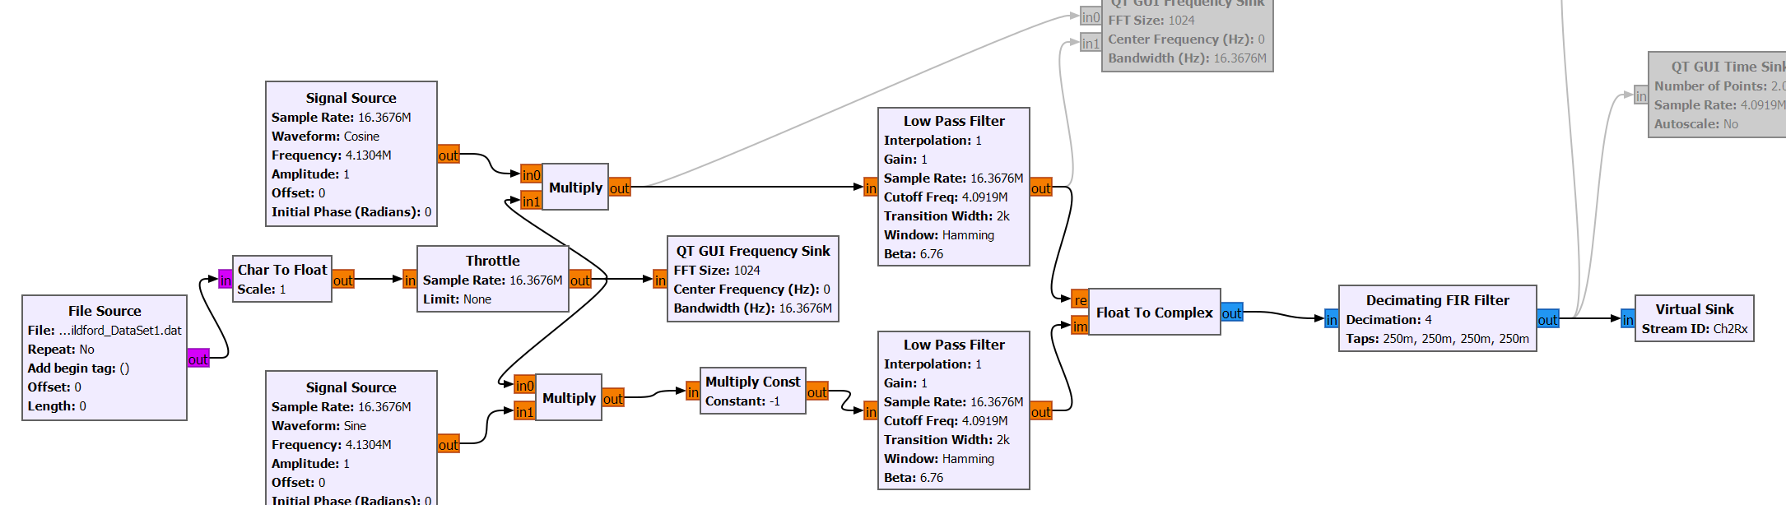
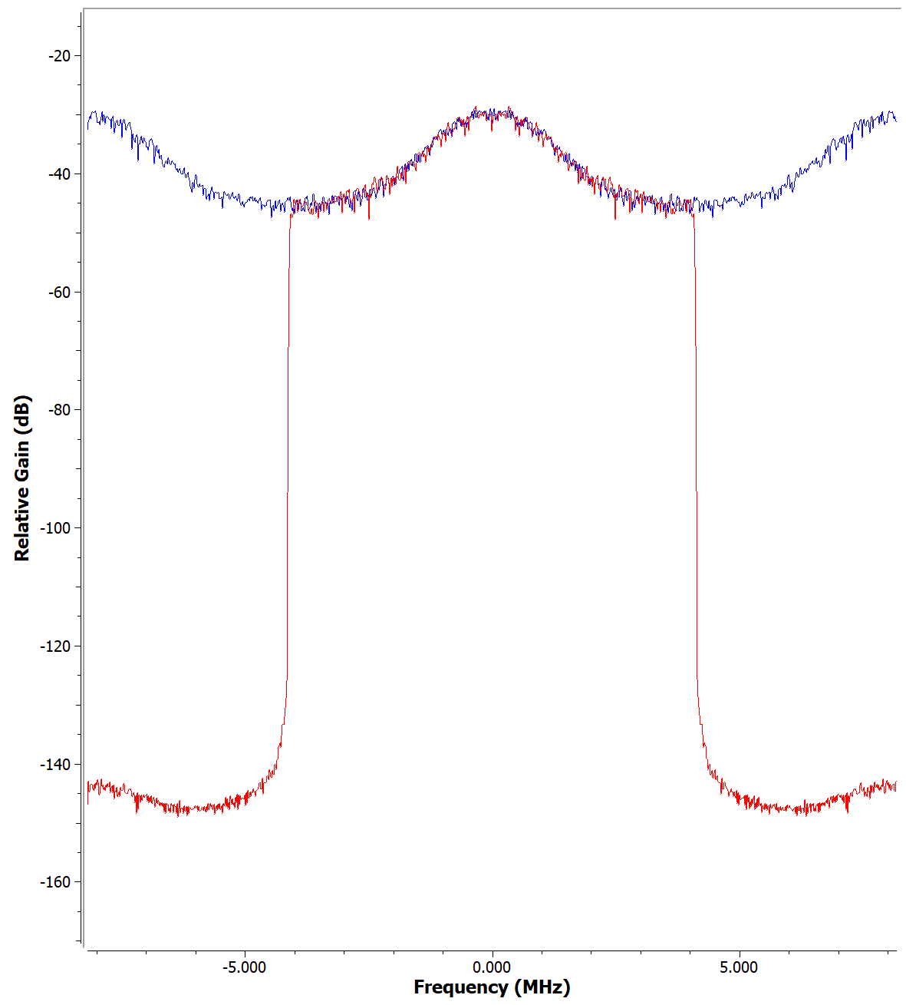
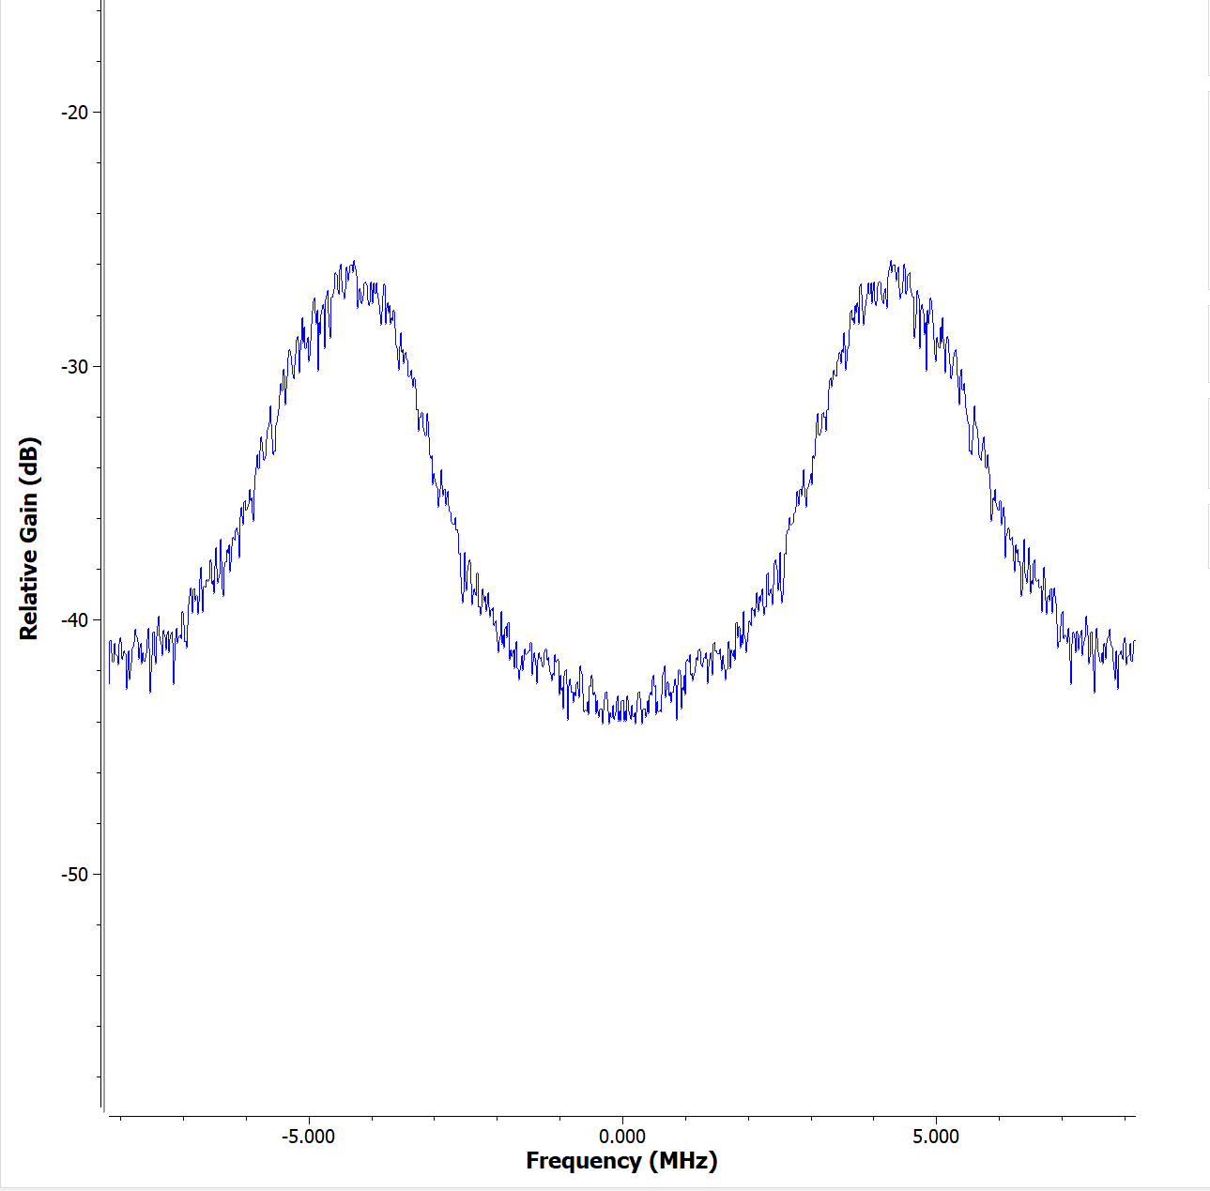
d. Validation 2 – Airborne GPS IF band data testing
IF band – Intermediate Frequency band (4.1304MHz)
IF band IQ sampled and down-converted to baseband
IF band spectrum
Baseband spectrum

Slide 14
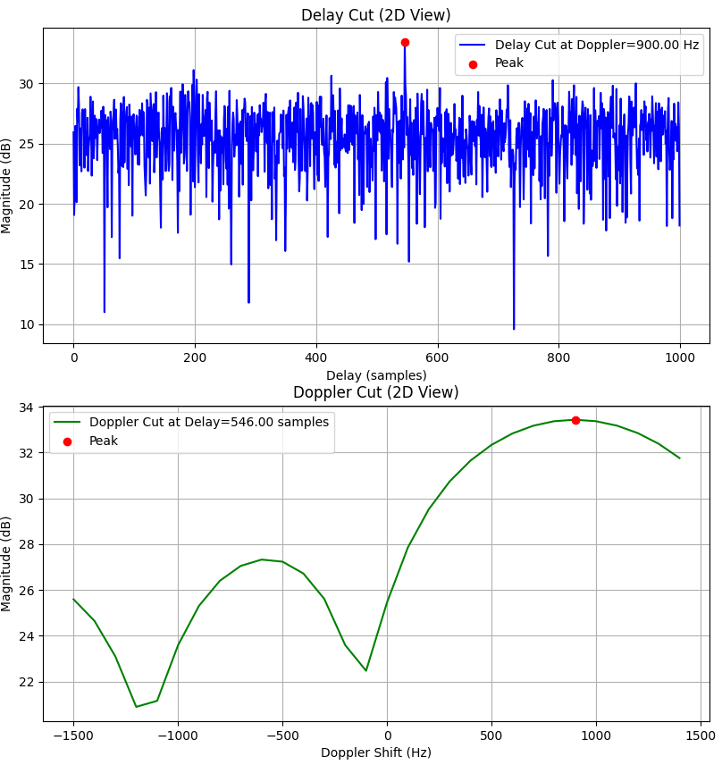
Compare the detected PRN with the reference result
Determine the peak detection threshold
Achieved 100% accuracy in PRN detection correctness
E.g. PRN 2
Notes:
For example, the receiver detected PRN2
the delay and doppler frequency correlation waveform (2d cuts along delay and doppler axis which contains the peak)
We need to find a way to find the peak and determine whether it’s a valid peak

Slide 15
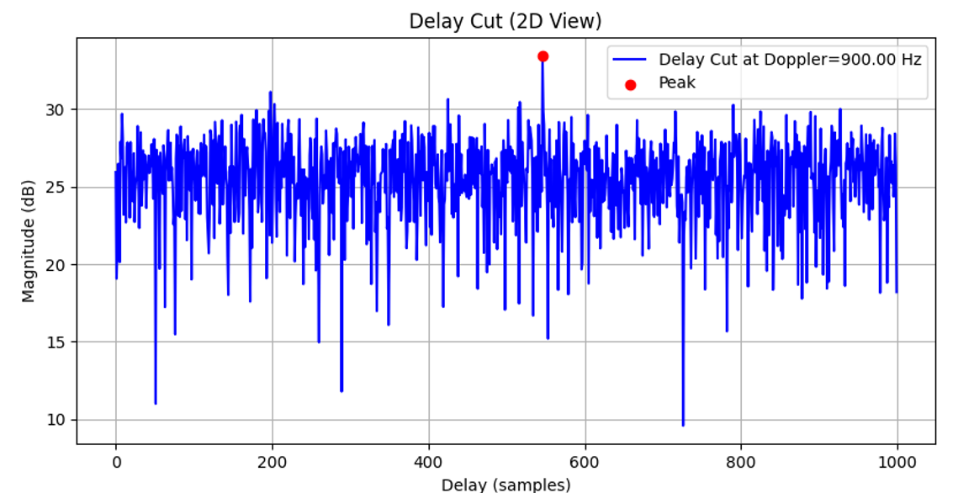
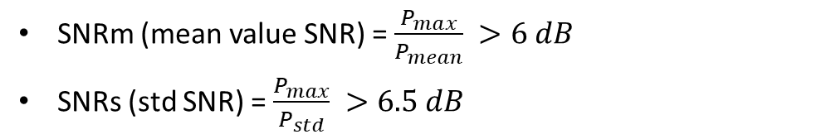
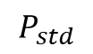
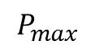
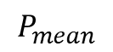
Peak Detection Threshold
SNRm (mean value SNR) = $\frac{P_{max}}{P_{mean}} >6 dB$
SNRs (std SNR) = $\frac{P_{max}}{P_{std}} >6.5 dB$
(Correlation Output)
$$P_{max}$$
$$P_{std}$$
$$P_{mean}$$

Slide 16
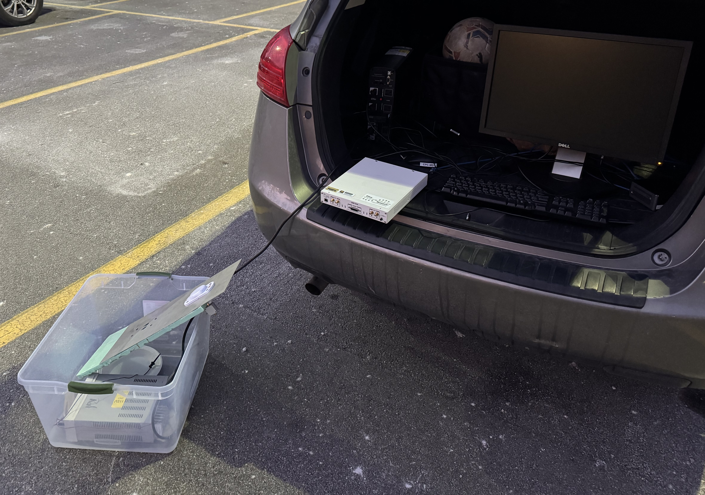
3. In-situ GPS Signal Measurement Experiment
UPS Power Source
NUC2 Computer
USRP
Active Antenna
With its ground plane
DC Supply

Slide 17
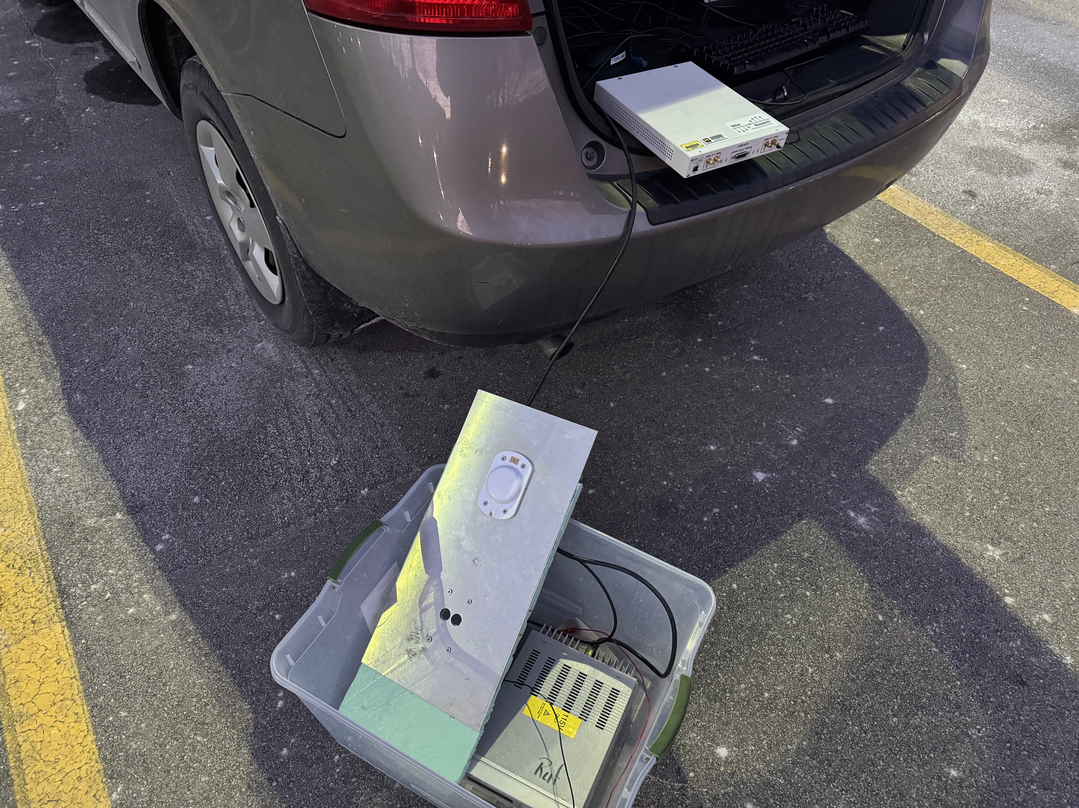
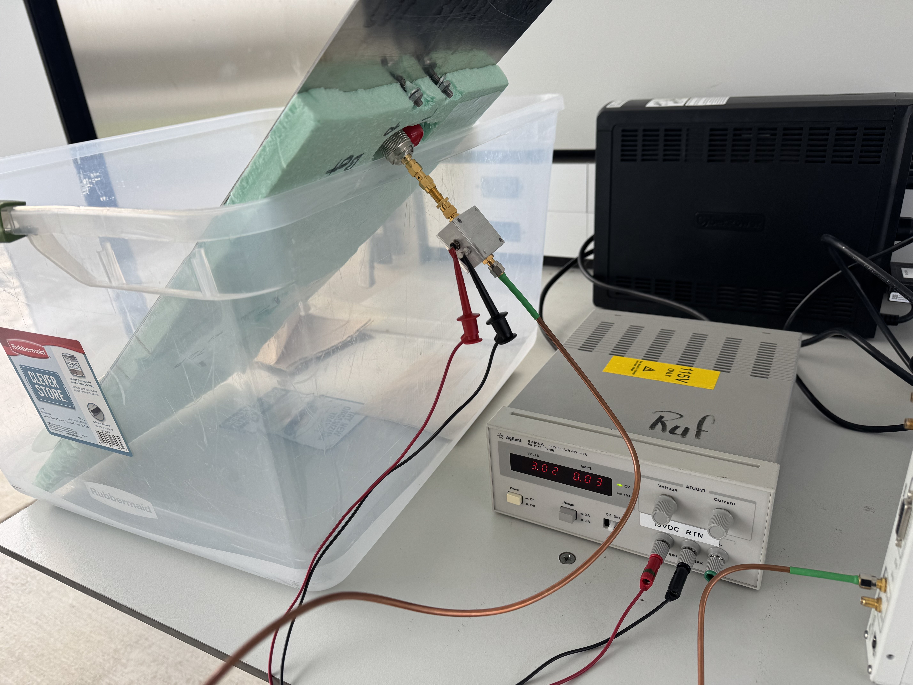
Active Antenna
Bias TEE

Slide 18
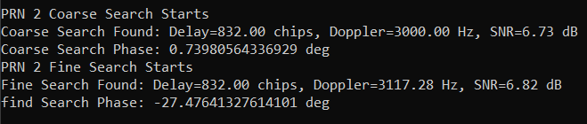
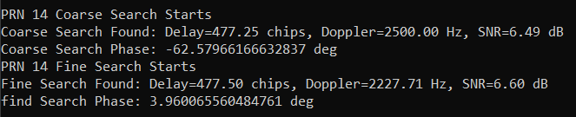
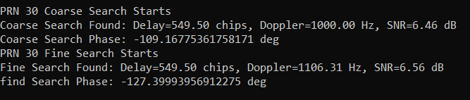
PRNs we found… PRN 2, PRN 14, PRN 30

Slide 19
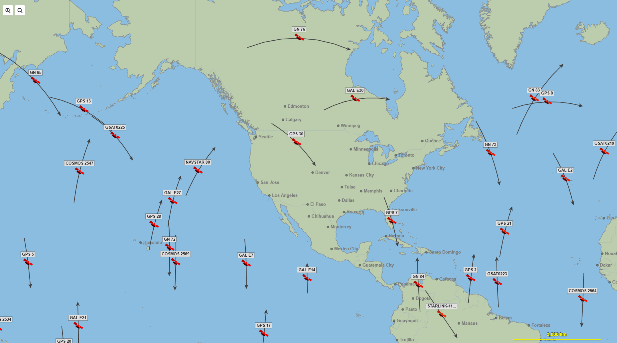
Navigation Satellite Positions at 12/7/2024, 17:15pm Eastern Time
PRN 14

Slide 20
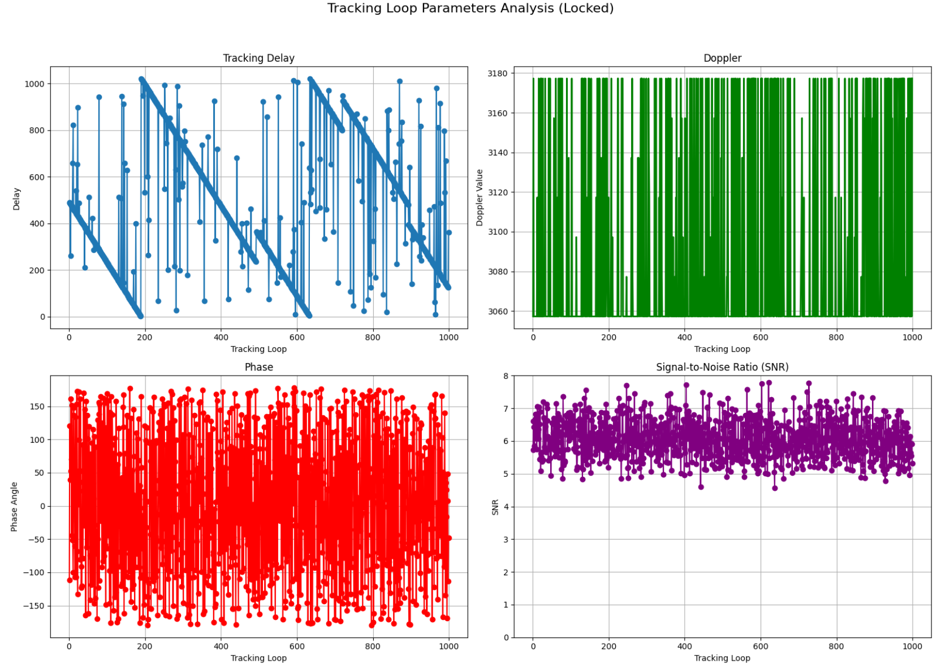
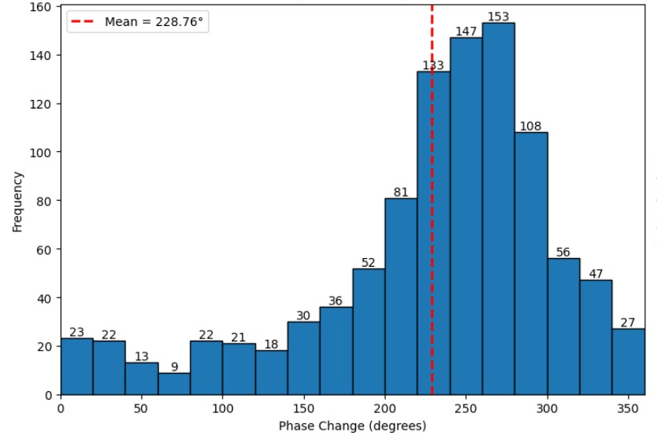
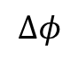
Tracking Results:
Tracking PRN 2: 1s data, 1000 code cycle tracking
Delay
Doppler
$$Δφ$$
Phase
SNRm
Gaussian like distribution

Slide 21
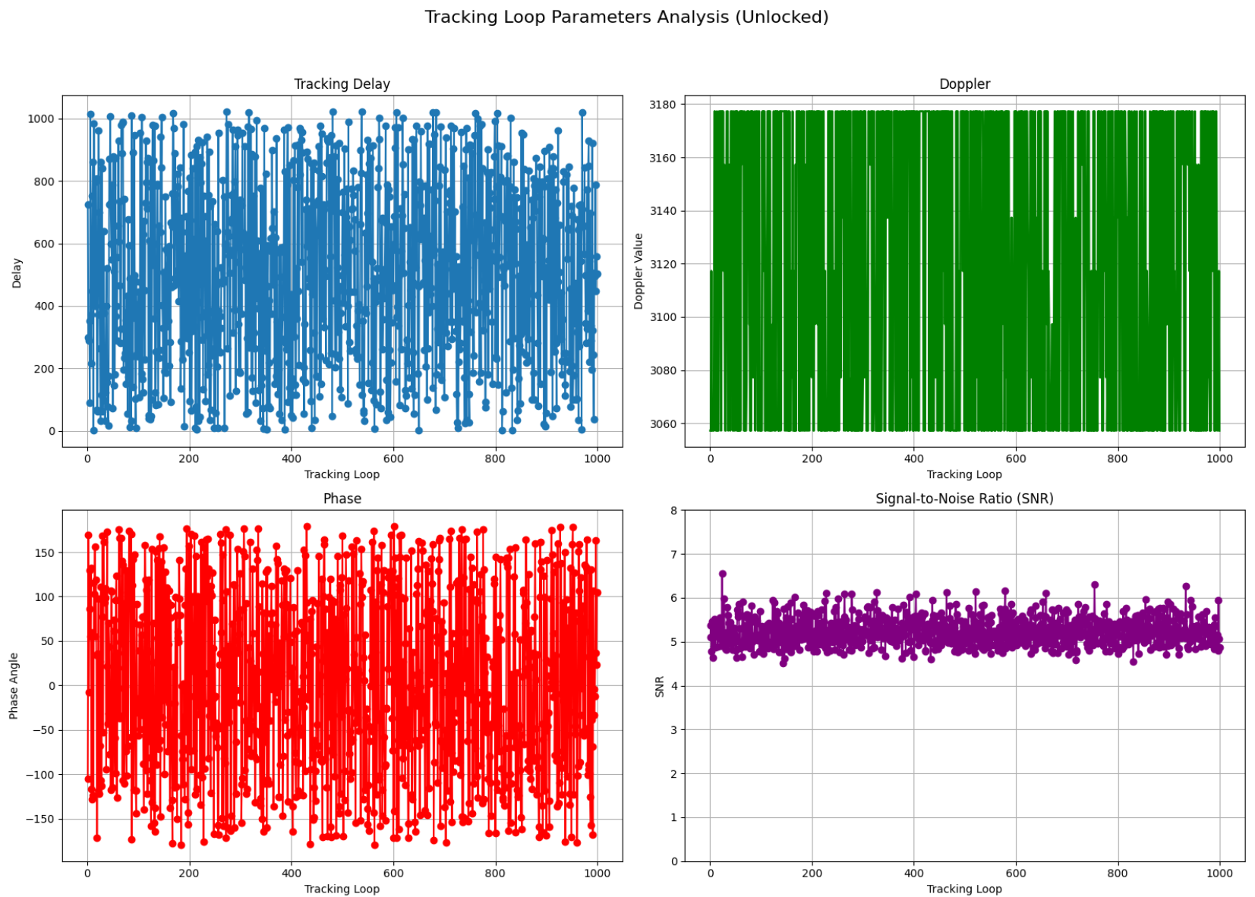
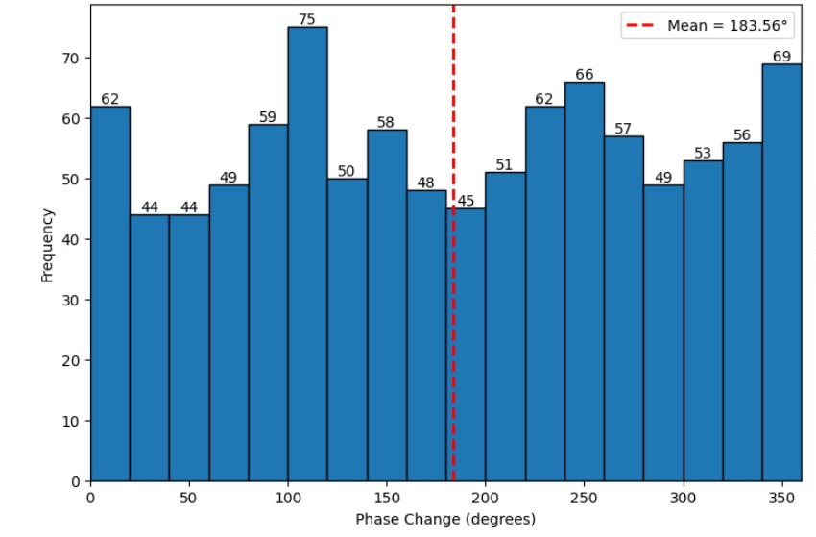
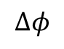
Tracking a PRN that is not detected
Delay
Doppler
$$Δφ$$
Phase
SNRm
Uniform distribution

Slide 22
4. Conclusions
We built a USRP-Gnuradio based GPS receiver
In the experiment, we managed to detect and track GPS satellite PRNs
However, we do not have enough time to do the remote sensing application
Also, the system is not suitable for remote sensing application
Discussion: The USRP received signal is very noisy compared with other GPS receivers
Noise figure might be too high – the system injects extra noise to the signal (filter, mixer, LNA…)
Phase noise is too high – Local oscillator is not good

Slide 23
Q & A

Slide 24
Tracking
Given the estimate delay and doppler in the 1st ms xcorr, the receiver knows where the signal is
Use phase lock loop (PLL), frequency lock loop (FLL), delay lock loop (DLL) to lock on the signal
They are feed back loops to the local oscillator & correlation delay & phase shifter
Use a cost function to estimate their bias, use PI control to feedback
Adjust the delay, doppler, phase in the next loop
Cold starts search for N delay * M doppler space, tracking only do 3 delay and 1 frequency search
This achieves real-time tracking
Phase lock? The carrier phase changes continuously, so we will see rotation in constellation plot. To parse the bpsk modulation of navigation bit correctly, we need to compensate the phase.

Slide 25
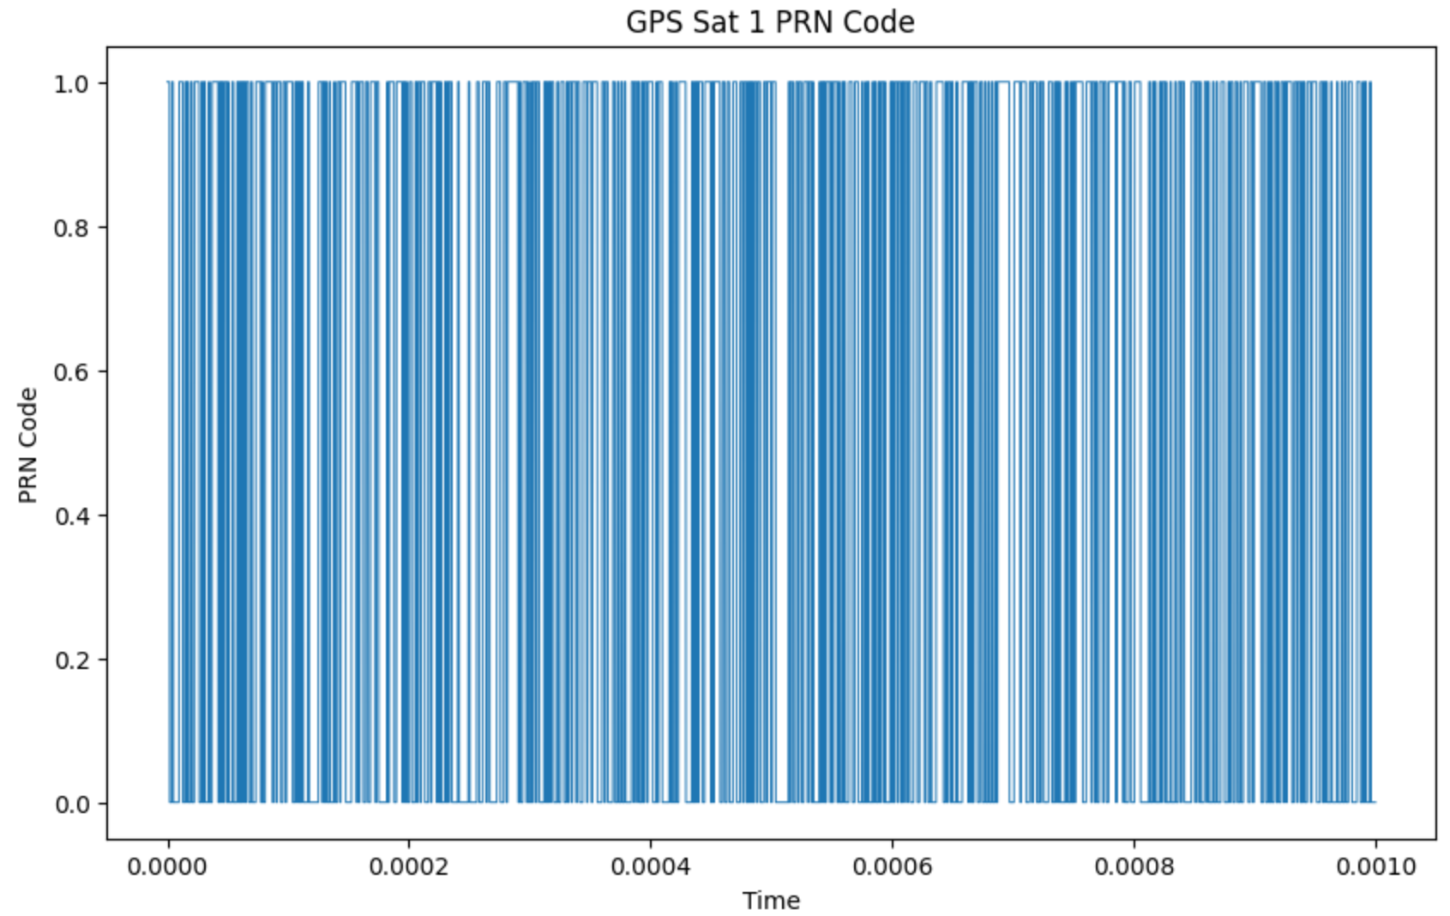
PRN code – L1 civil ranging code
C/A Code – Gold Code
One period: 1023 bits
Chipping rate: 1023 Kbps
Every period lasts 1 ms

